Slide 1
Data 604 - Final Project Basic Simulation of a family practician waiting queue
Deepak Mongia

Slide 2
Problem at hand
To understand how a family physician queue would behave
With different values of the system variables, how the queuing will vary in performance
Does the clinic need an extra doctor or an extra reception staff ?

Slide 3
Outpatient Flow at a clinic
Patient Arrival
Reception
Waiting Queue
Doctor
Out

Slide 4
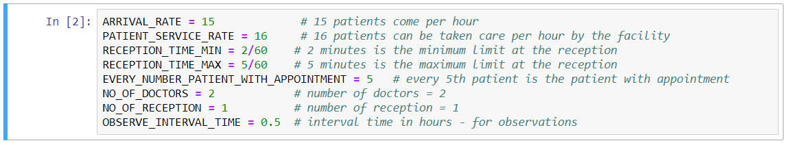
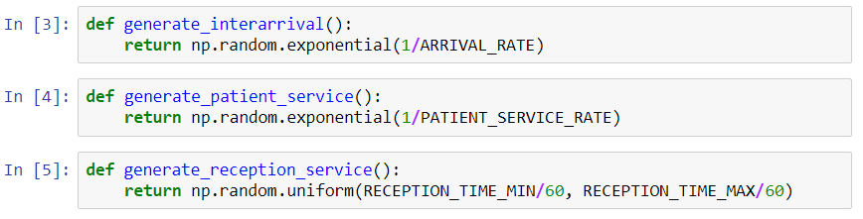
System Parameters

Slide 5
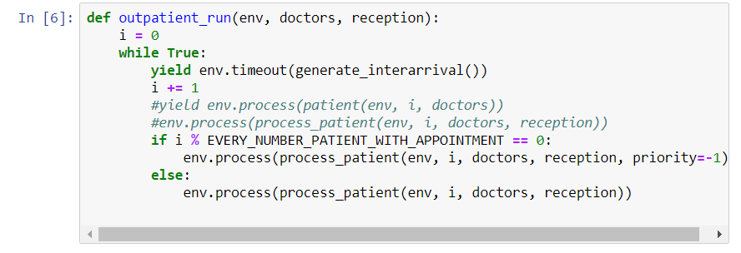
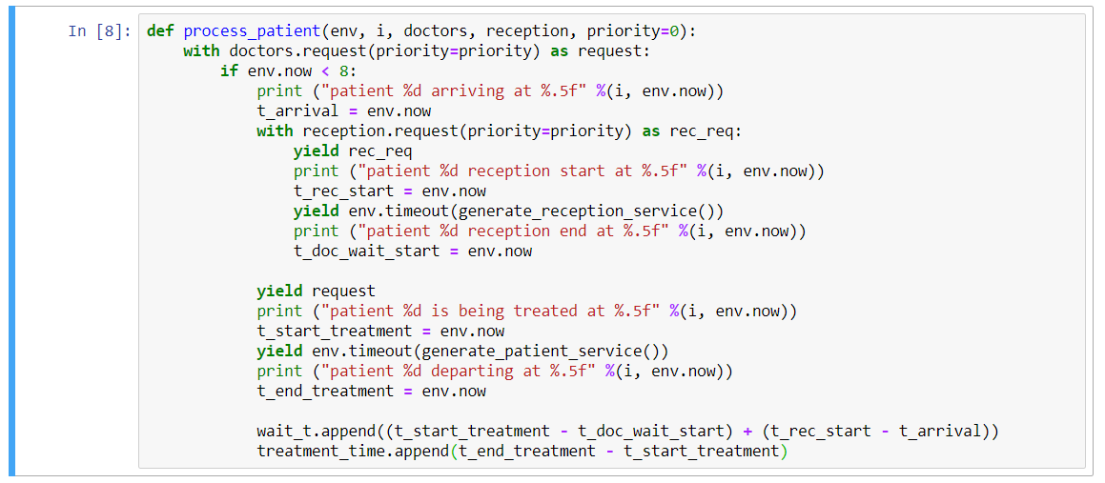
Main Process and Logic

Slide 6
Main Features considered
Separate resources and time frames for reception and doctor
Patients with appointments or high priorty
Balking - for patients coming after the clinic closes
Audit done for
- waiting times - waiting for reception + waiting for doctor
- queue length
- resource utilization

Slide 7
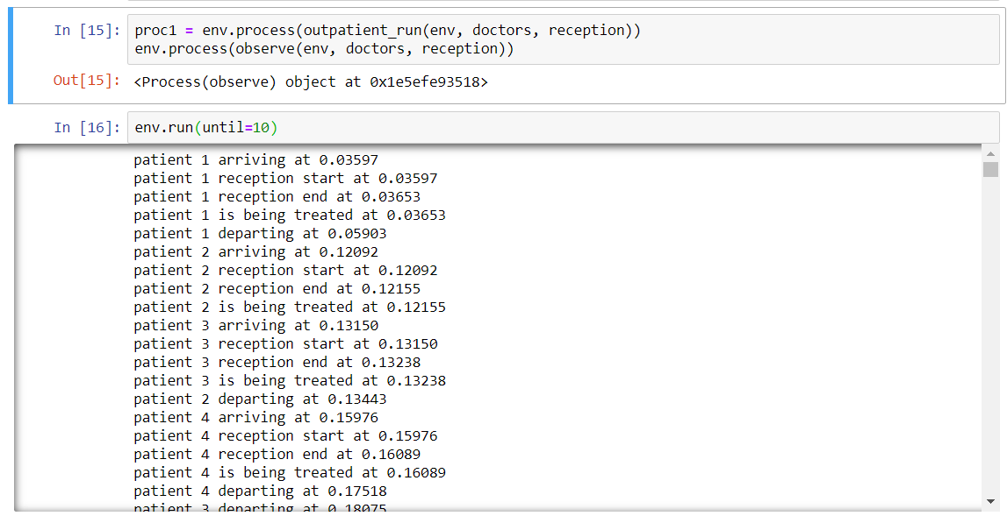
Outputs / Findings

Slide 8
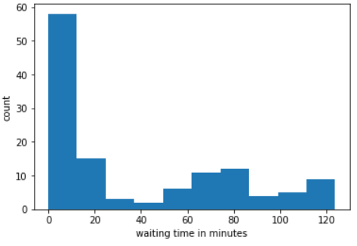
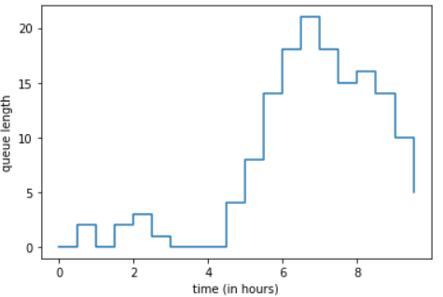
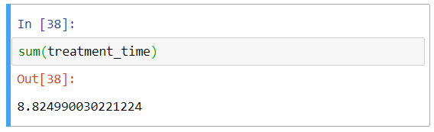
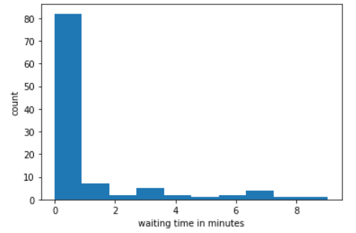
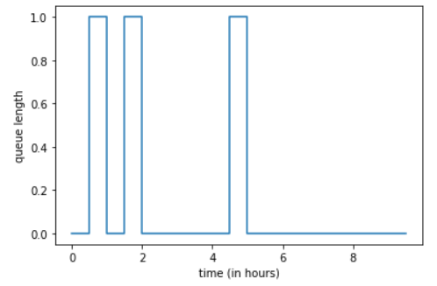
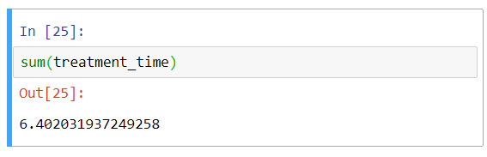
Conclusion:
Wait Time - Plots
Queues - Length
1 doctor
2 doctors

